Slide 1

CSCE 120/121 Introduction to Program Design & Concepts
Advanced Classes and the Rule of 3
Dr. Tim McGuire
Grateful acknowledgment to Dr. Philip Ritchey and Dr. Michael Moore for some of the material on which these slides are based.

Slide 2
The Rule of 3
Classes have three special member functions that are commonly implemented together:
Destructor: A destructor is a class member function that is automatically called when an object of the class is destroyed, such as when the object goes out of scope or is explicitly destroyed as in delete someObject;.
Copy constructor: A copy constructor is another version of a constructor that can be called with a single pass by reference argument. The copy constructor is automatically called when an object is passed by value to a function, such as for the function
Copy assignment operator: The assignment operator "=" can be overloaded for a class via a member function, known as the copy assignment operator, that overloads the built-in function "operator=", the member function having a reference parameter of the class type and returning a reference to the class type.

Slide 3
The Rule of Three
The rule of three describes a practice that if a programmer explicitly defines any one of those three special member functions (destructor, copy constructor, copy assignment operator), then the programmer should explicitly define all three.
For this reason, those three special member functions are sometimes called the big three.

Slide 4
Destructors
Member function automatically called when an object is destroyed
Destructor name is ~classname, e.g., ~Rectangle
Has no return type; takes no arguments
Only one destructor per class, i.e., it cannot be overloaded
If constructor allocates dynamic memory, destructor should release it

Slide 5
Rationale for the Rule of 3
Destructor
Important for avoiding memory leaks.
Copy Assignment Operator:
If you do not provide one the compiler creates a default assignment operator.
The default assignment operation is a member-wise copy function and does a shallow copy and not a deep copy.
This could cause problems like memory leaks, wrong assignment.
Copy Constructor
The rationale is similar to that of the Copy Assignment Operator

Slide 6
See destructor.cpp

Slide 7
Constructors, Destructors, and Dynamically Allocated Objects
When an object is dynamically allocated with the new operator, its constructor executes: Rectangle *r = new Rectangle(10, 20);
When the object is destroyed, its destructor executes: delete r;
See ContactInfo.h and ContactInfo.cpp

Slide 8
Instance and Static Members

Slide 9
Instance and Static Members
instance variable: a member variable in a class. Each object has its own copy.
Static variable: one variable shared among all objects of a class
static member function: can be used to access static member variable; can be called before any objects are defined

Slide 10
static member variable
Contents of Tree.h
1 // Tree class 2 class Tree 3 { 4 private: 5 static int objectCount = 0; // Static member variable. 6 public: 7 // Constructor 8 Tree() 9 { objectCount++; } 10 11 // Accessor function for objectCount 12 int getObjectCount() const 13 { return objectCount; } 14 }; 15 16 // Definition of the static member variable, written 17 // outside the class. 18 int Tree::objectCount = 0;
Static member declared here.
Static member defined here.

Slide 11
See tree.cpp

Slide 12
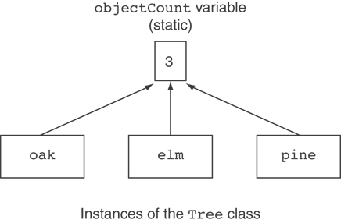
Three Instances of the Tree Class, But Only One objectCount Variable

Slide 13
static member function
Can declare static functions as well as static variables
Declared with static before return type:
static int getObjectCount() const
{ return objectCount; }
Static member functions can only access static member data
Can be called independent of objects: int num = Tree::getObjectCount();

Slide 14
Modified Version of Tree.h
1 // Tree class 2 class Tree 3 { 4 private: 5 static int objectCount; // Static member variable. 6 public: 7 // Constructor 8 Tree() 9 { objectCount++; } 10 11 // Accessor function for objectCount 12 static int getObjectCount() const 13 { return objectCount; } 14 }; 15 16 // Definition of the static member variable, written 17 // outside the class. 18 int Tree::objectCount = 0;
Now we can call the function like this: cout << "There are " << Tree::getObjectCount() << " objects.\n";

Slide 15
Friends of Classes

Slide 16
Friends of Classes
Friend: a function or class that is not a member of a class, but has access to private members of the class
A friend function can be a stand-alone function or a member function of another class
It is declared a friend of a class with friend keyword in the function prototype

Slide 17
Why friends?
Class operations are typically implemented as member functions
Some operations are better implemented as ordinary (nonmember) functions

Slide 18
Example: DayMonth Class
Class DayMonth { private: int month; int day; public: int getMonth(); int getDay(); setMonth(); setDay();
…. etc…. }

Slide 19
Program Example: An Equality Function
The DayMonth class can be enhanced to include an equality function
An equality function tests two objects of type DayMonth to see if their values represent the same date
Two dates are equal if they represent the same day and month
We want the equality function to return a value of type bool that is true if the dates are the same
The equality function requires a parameter for each of the two dates to compare
The declaration is bool equal(DayMonth date1, DayMonth date2);
Notice that equal is not a member of the class DayMonth

Slide 20
Defining Function equal
The function equal, is not a member function
It must use public accessor functions to obtain the day and month from a DayMonth object
equal can be defined in this way: bool equal(DayMonth date1, DayMonth date2) { return ( date1.getMonth( ) == date2.getMonth( ) && date1.getDay( ) == date2.getDay( ) ); }

Slide 21
Using The Function equal
The equal function can be used to compare dates in this manner if ( equal( today, bach_birthday) ) cout << "It's Bach's birthday!";

Slide 22
Is equal Efficient?
Function equal could be made more efficient
Equal uses member function calls to obtain the private data values
Direct access of the member variables would be more efficient (faster)

Slide 23
A More Efficient equal
As defined here, equal is more efficient, but not legal bool equal(DayMonth date1, DayMonth date2) { return (date1.month = = date2.month && date1.day = = date2.day ); }
The code is simpler and more efficient
Direct access of private member variables is not legal!

Slide 24
Declaring A Friend
The function equal is declared a friend in the abbreviated class definition here class DayMonth { public: friend bool equal(DayMonth date1, DayMonth date2); // The rest of the public members private: // the private members };

Slide 25
Are Friends Needed?
Friend functions can be written as non-friend functions using the normal accessor and mutator functions that should be part of the class
The code of a friend function is simpler and it is more efficient
So, the short answer is “NO”

Slide 26
Choosing Friends
How do you know when a function should be a friend or a member function?
In general, use a member function if the task performed by the function involves only one object
In general, use a nonmember function if the task performed by the function involves more than one object
Choosing to make the nonmember function a friend is a decision of efficiency and personal taste

Slide 27
Copy Constructors

Slide 28
Copy Constructors
Special constructor used when a newly created object is initialized to the data of another object of same class
Default copy constructor copies field-to-field
Default copy constructor works fine in many cases

Slide 29
Why Copy Constructors?
Problem: what if an object contains a pointer?
class SomeClass
{ public:
SomeClass(int val = 0)
{value=new int; *value = val;}
int getVal();
void setVal(int);
private:
int *value;
}

Slide 30
Copy Constructors
What we get using memberwise copy with objects containing dynamic memory:
SomeClass object1(5);
SomeClass object2 = object1;
object2.setVal(42);
cout << object1.getVal(); // also 42
42
object1
object2
value
value

Slide 31
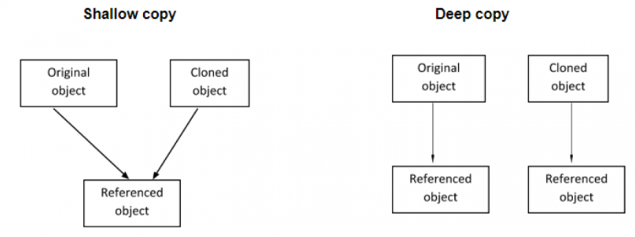

Slide 32
Copy Constructors
The problem with using call-by-value parameters with pointer variables is solved by the copy constructor.
A copy constructor is a constructor with one parameter of the same type as the class
The parameter is a call-by-reference parameter
The parameter is usually a constant parameter
The constructor creates a complete, independent copy of its argument

Slide 33
Programmer-Defined Copy Constructor
Allows us to solve problem with objects containing pointers:
SomeClass::SomeClass(const SomeClass &obj)
{
value = new int;
*value = obj.value;
}
Copy constructor takes a reference parameter to an object of the class

Slide 34
Programmer-Defined Copy Constructor
Each object now points to separate dynamic memory:
SomeClass object1(5);
SomeClass object2 = new SomeClass(object1);
object2.setVal(42);
cout << object1.getVal(); // still 5
5
42
object1
object2
value
value

Slide 35
Programmer-Defined Copy Constructor
Since copy constructor has a reference to the object it is copying from,
SomeClass::SomeClass(SomeClass &obj)
it can modify that object.
To prevent this from happening, make the object parameter const:
SomeClass::SomeClass(const SomeClass &obj)

Slide 36
When To Include a Copy Constructor
When a class definition involves pointers and dynamically allocated memory using "new", include a copy constructor
Classes that do not involve pointers and dynamically allocated memory do not need copy constructors

Slide 37
Operator Overloading
Notes:
C++ allows you to redefine how standard operators work when used with class objects.

Slide 38
Operator Overloading
Operators such as =, +, and others can be redefined when used with objects of a class
The name of the function for the overloaded operator is operator followed by the operator symbol, e.g.,
operator+ to overload the + operator, and
operator= to overload the = operator
Prototype for the overloaded operator goes in the declaration of the class that is overloading it
Overloaded operator function definition goes with other member functions
Notes:
C++ allows a class to have special member functions called operator functions . If you wish to redefine the way a particular operator works with an object, you define a function for that operator.

Slide 39
The this Pointer
this: predefined pointer available to a class’s member functions
Always points to the instance (object) of the class whose function is being called
Is passed as a hidden argument to all non-static member functions

Slide 40
The this Pointer
Example, student1 and student2 are both StudentTestScores objects.
The following statement causes the getStudentName member function to operate on student1: cout << student1.getStudentName() << endl;
When getStudentName is operating on student1, the this pointer is pointing to student1.

Slide 41
The this Pointer
Likewise, the following statement causes the getStudentName member function to operate on student2: cout << student2.getStudentName() << endl;
When getStudentName is operating on student2, the this pointer is pointing to student2.
The this pointer always points to the object that is being used to call the member function.

Slide 42
Operator Overloading
Prototype:
void operator=(const SomeClass &rval)
Operator is called via object on left side
parameter for
object on right
side of operator
return
type
function
name
Notes:
First look at the function header: The name of the function is operator =. This specifies that the function overloads the = operator.
Because it is a member of the SomeClass class, this function will be called only when an assignment statement executes where the object on the left side of the = operator is a SomeClass object.

Slide 43
Invoking an Overloaded Operator
Operator can be invoked as a member function:
object1.operator=(object2);
But if we did it that way, we might as well have just called it “assign” and invoke it this way: object1.assign(object2);
Instead, we can can use it this way:
object1 = object2;
Notes:
The function has one parameter: a constant reference object named right . This parameter references the object on the right side of the operator.
For example, when the following statement is executed, right will reference the object named object
right is declared as a const reference for the following reasons:
• It was declared as a reference for efficiency purposes. This prevents the compiler from making a copy of the object being passed into the function.
• It was declared constant so the function will not accidentally change the contents of the argument.

Slide 44
Returning a Value
An overloaded operator can return a value
class Point2d
{
private:
int x, y;
...
public:
double operator-(const point2d &right)
{ return sqrt(pow((this.x-right.x),2) + pow((this.y-right.y),2)); }
};
Point2d point1(2,2), point2(4,4);
// Compute and display distance between 2 points.
cout << point2 – point1 << endl; // displays 2.82843
We could simply say x-right.x here, but the use of this reminds us that x belongs to the calling object.

Slide 45
The Big Three
So, now we have seen
Destructors
Copy Constructors
Assignment Operators
If you need to define one, you need to define all

Slide 46
Notes on Overloaded Operators
Can change meaning of an operator
Cannot change the number of operands of the operator
Overloaded relational operators should return a bool value
Overloaded stream operators >>, << must return reference to istream, ostream objects

Slide 47
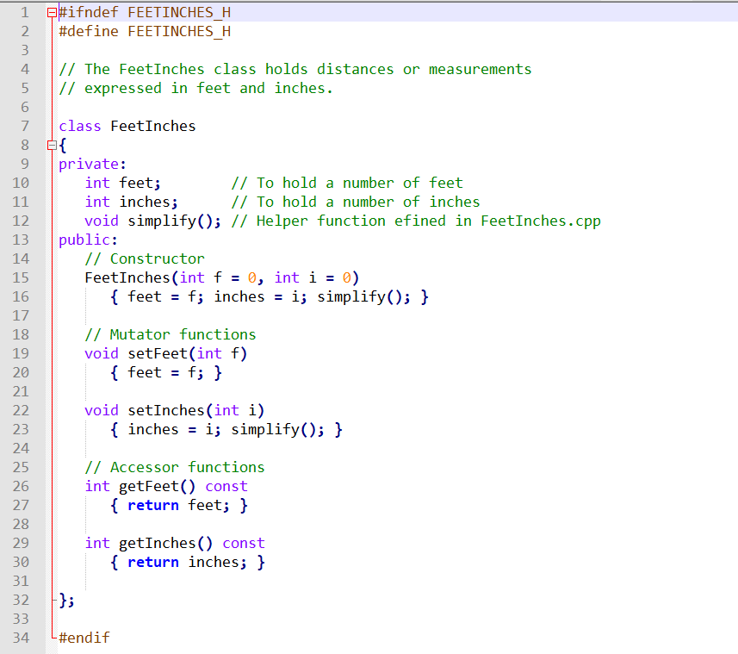
Modified from an example by Tony Gaddis
Notes:
Here’s an example of a class that would benefit from overloaded math operators.
The FeetInches class is designed to hold distances or measurements expressed in feet and inches. It has:
• A constructor that allows the feet and inches members to be set. The default values for these members is zero.
• Accessor and mutator functions
• A simplify function for normalizing the values held in feet and inches . This function adjusts any set of values where the inches member is greater than 12 or less than 0.

Slide 48
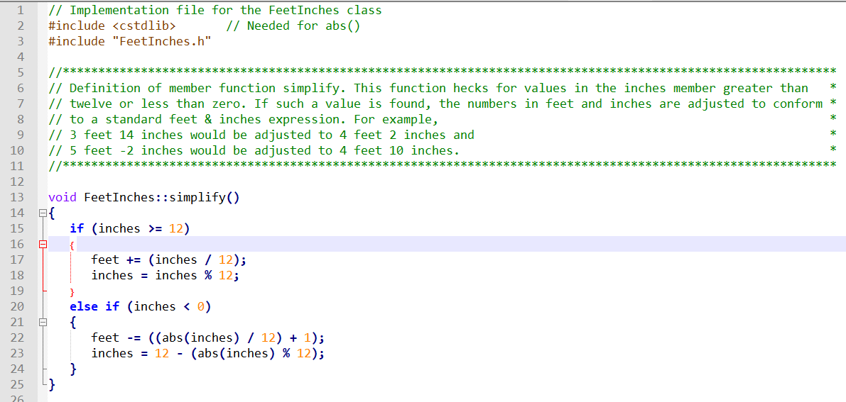
Notes:
• A simplify function for normalizing the values held in feet and inches . This function adjusts any set of values where the inches member is greater than 12 or less than 0.
The simplify function uses the standard library function abs() to get the absolute value of the inches member. The abs() function requires that cstdlib be included.

Slide 49

Notes:
And here’s an example of a main function which reads in two lengths, and adds them together using the getters and setters.
(Let the code window float in)
It works, but wouldn’t it be

Slide 50
Notes:
Now let’s add
• An operator + function that overloads the standard + math operator.
• An operator − function that overloads the standard − math operator.
(Let them fly in)
The overloaded + and − operators allow one FeetInches object to be added to or subtracted from another.

Slide 51
Notes:
And here’s the implementation of them. Let’s look at the + operator
(let it fly in)
This function is called anytime the + operator is used with two FeetInches objects.
This function has one parameter: a constant reference object named right .
This parameter references the object on the right side of the operator.
We create a new object, temp, to hold the results of the addition.
Inches and feet are members of the object making the function call.
right.inches references the inches of the object passes as a parameter, etc.
Finally, we adjust the values so they conform to a normal value expressed in feet and inches by calling temp. simplify() :

Slide 52
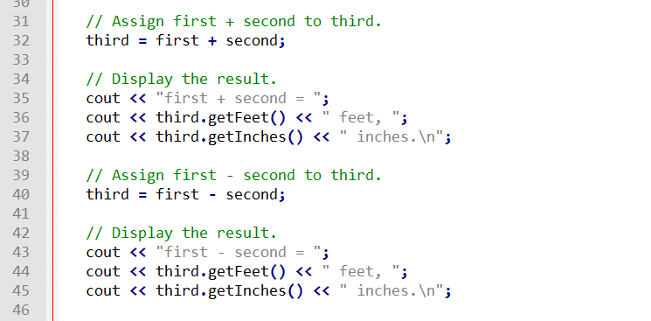

Notes:
Because the + operator is overloaded, we can add these two objects in a statement such as:
third = first + second;
That’s a lot simpler than the way we did it before (show the first animation)
But really, what’s going on behind the scenes is that first is calling it’s overloaded + operator like this (second animation)

